Slide 1

ICOS Big Data Camp visualization Basics
Visualization Basics - From Chart to Art
Created by A. R. Azari 5/16/2018
General Resources –
Visual Strategies: A Practical Guide to Graphics and Engineers, Frankel and Depace – 2012.
Color Design Workbook: A Real World Guide to Using Color in Graphic Design, Sean Adams, 2008.
Milestones in the History of Thematic Cartography, Statistical Graphics, and Data Visualization, Friendly & Denis http://euclid.psych.yorku.ca/SCS/Gallery/milestone/
Graphical Perception: Theory, Experimentation, and Application to the Development of Graphical Methods. Cleveland & McGill 1984.
Articles found within https://www.pictureasportal.com/pages/resources
Justin Joque at UM Library - http://justinjoque.com/visualization.php, https://www.lib.umich.edu/users/joque

Slide 2
Visualization of Information -
How can we:
1) convey our data most informatively (accuracy)?
and…use the tools we have (In Python!), to
2) create interesting and approachable graphics (aesthetics)?

Slide 3
The beginning of a more familiar statistical data visualization
With the beginning of modern statistics & probability theory in (late 1700s – 1900s) came a surge of info-graphics and visualizations
Let’s take a look at some of these early charts together – split into small groups around the papers handed out -
What these graphics are conveying (best guess)?
What you find familiar about them / unfamiliar?
What do you find confusing, what do you find interesting?

Slide 4
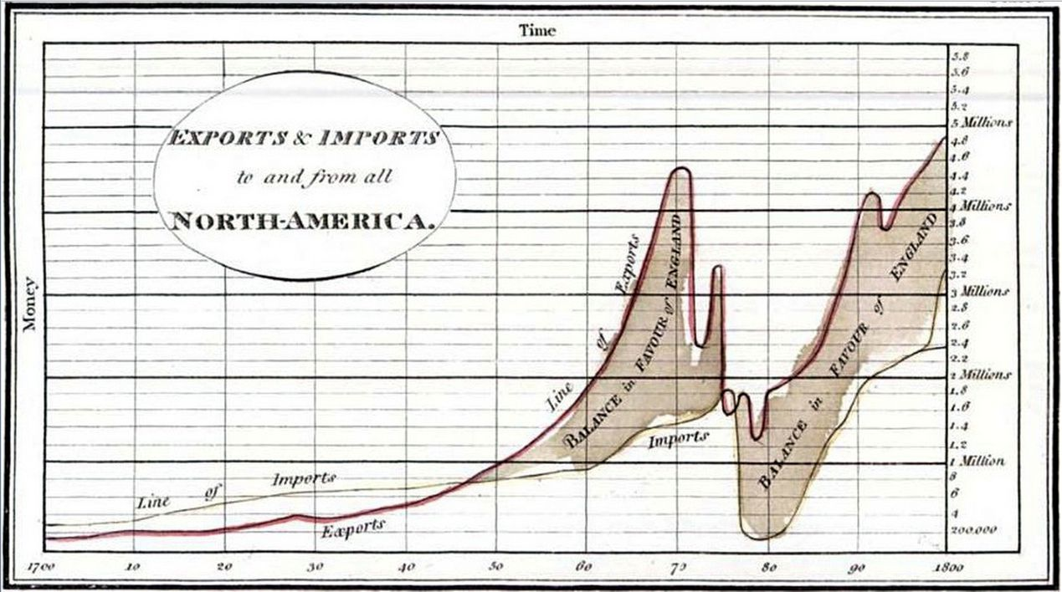
William Playfair’s Charts – 1786 Sidenote - 2017 total was ~56 billion exported to UK from US, and ~ 53 billion imported from US to UK.

Slide 5
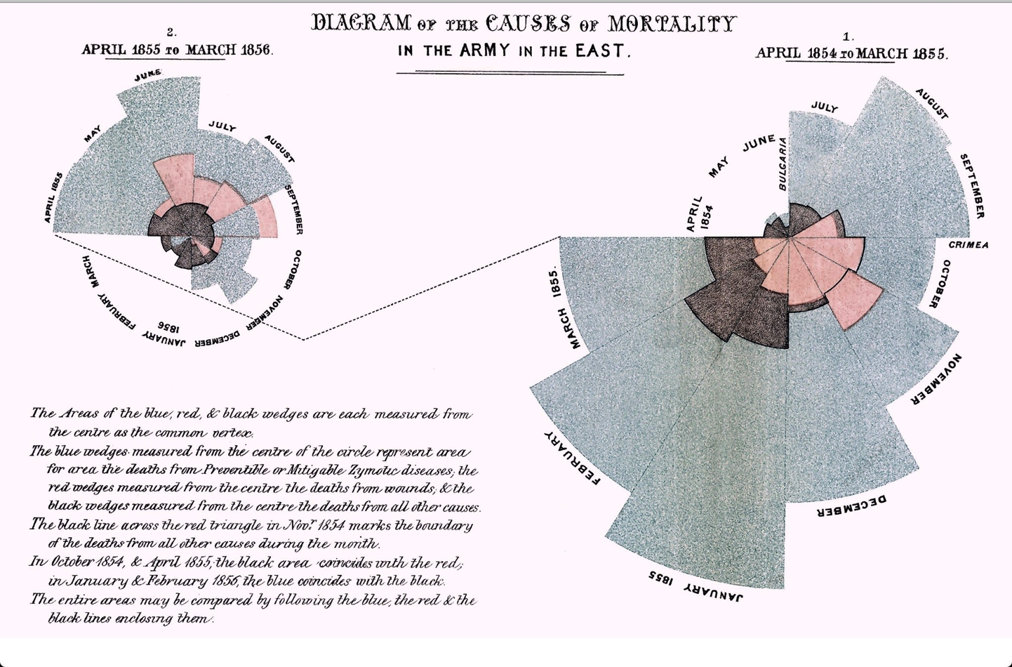
Florence Nightingale’s Report - ~1858

Slide 6

The “Minard Map” - 1869
Notes:
This has been called the best statistical drawing ever created.

Slide 7
What did these all have in common?
Why do you think they were made?

Slide 8
What did these all have in common?
Why do you think they were made?
The main point of these data graphics were to convince someone (mostly a government) of certain ideas or realities to push forward public policy
Their choice of presentation of the data is therefore made to create conversation around a certain topic or point -

Slide 9
What did these all have in common?
Why do you think they were made?
The main point of these data graphics were to convince someone (mostly a government) of certain ideas or realities to push forward public policy
Their choice of presentation of the data is therefore made to create conversation around a certain topic or point -
How can we implement “good design” as we make our own visualizations and infographics for research?

Slide 10
What constitutes a “good visualization”?
This is a rather subjective question to ask people…what do YOU think?

Slide 11
What constitutes a “good visualization”?
This is a rather subjective question to ask people…what do YOU think?
Does color matter?

Slide 12
What constitutes a “good visualization”?
This is a rather subjective question to ask people…what do YOU think?
Does color matter?
What colors are best?

Slide 13
What constitutes a “good visualization”?
This is a rather subjective question to ask people…what do YOU think?
Does color matter?
What colors are best?
Is 3D better than 2D?

Slide 14
What constitutes a “good visualization”?
This is a rather subjective question to ask people…what do YOU think?
Does color matter?
What colors are best?
Is 3D better than 2D?
What about interactive graphics? Are those better?

Slide 15
What constitutes a “good visualization”?
This is a rather subjective question to ask people…what do YOU think?
Does color matter?
What colors are best?
Is 3D better than 2D?
What about interactive graphics? Are those better?
What it all comes down to is: – who is your audience and what point are you trying to make
As you make your graphics – ask yourself the following questions…

Slide 16
First Step Making a Visualization – Ask Yourself:
1) Is the graphic explanatory or exploratory?
Explanatory – you are trying to make a point, ask yourself what is the point you are trying to make?
Exploratory – you are inviting the viewer to explore the dataset, make their own inferences
Often the very first graphics you make in your work and research will be exploratory and then you finalize into an explanatory graphic.
Based on Frankel and DePace, 2012.

Slide 17
First Step Making a Visualization – Ask Yourself:
2) How will the graphic be used?
In an oral presentation you want something understood without much staring at the data – simplicity is best in this case
In a paper or a written document – perhaps more detail that invites the viewer to explore is better.
Above all – know you audience – what can you take for granted they know, what might they need as explanation
Based on Frankel and DePace, 2012.

Slide 18
First Step Making a Visualization – Ask Yourself:
3) What is the first thing you want the audience to see?
All graphics have a “flow” to them. Most audiences are familiar with bar charts, line plots etc – if you want to get creative try to make the viewer know where to look and what the message should be
You can use annotation, lines etc.
Just try to keep it simple.
For example…
Based on Frankel and DePace, 2012.

Slide 19
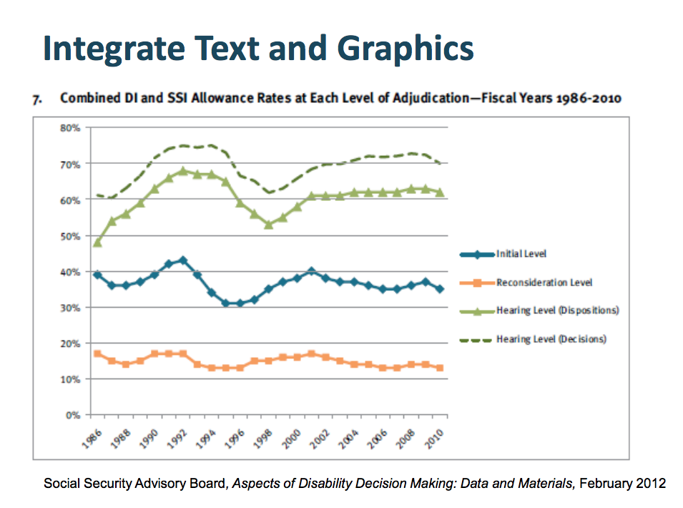
Example of accentuating communication
Adapted from Telling Visual Stories About Data, Congressional Budget Office, Fontaine, 2014.

Slide 20
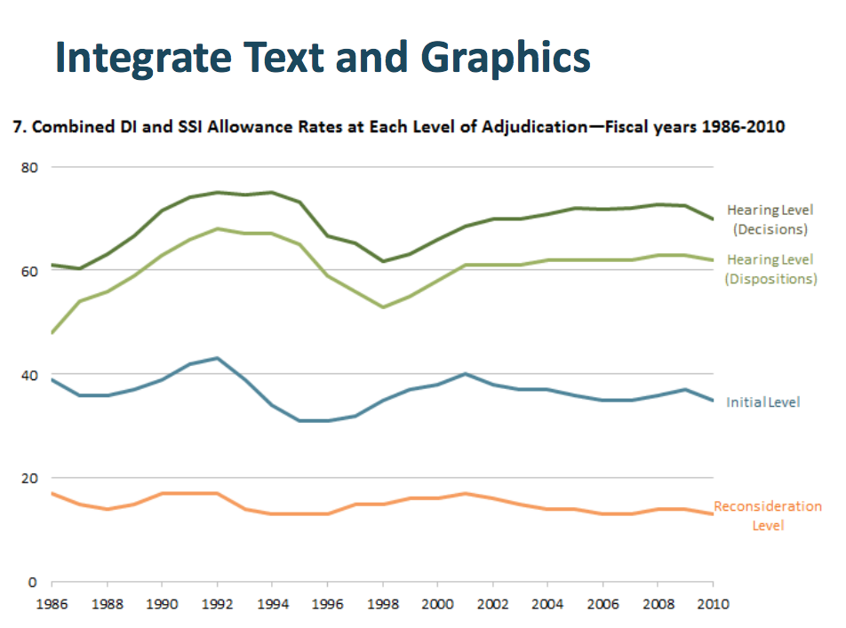
Example of accentuating communication
Adapted from Telling Visual Stories About Data, Congressional Budget Office, Fontaine, 2014.

Slide 21
Once you have an idea of what you want to present and to whom…
Consider the following steps and design elements
Compose
Organizing elements, defining relationships
Abstract
Define and represent the meaning
Color (my personal favorite)
Chose your colors to highlight relationships, label, attract or downplay interest
Layer
Overlap multiple objects to create relationships
Refine
Edit and simplify to the most direct communication possible
Based on Frankel and DePace, 2012.

Slide 22
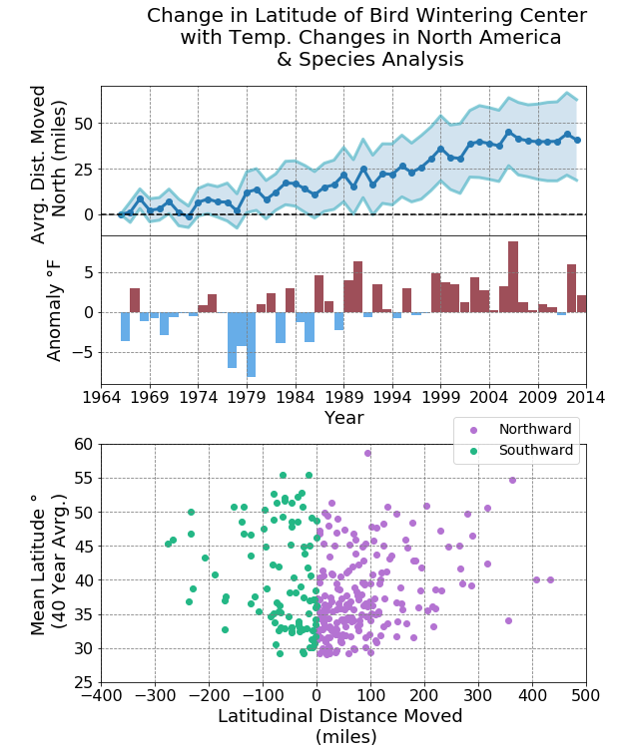
Element 1 – Composition – how your figure “flows” What relationships are you highlighting?
This is an example of data we are going to use (THURSDAY) in Python
We merged this axis, to make them more comparable for the reader
While these data are of different TYPE (one is time dependent, one is not) so we keep them separate
Figure from https://github.com/astro-abby/
Based on Frankel and DePace, 2012.

Slide 23
Element 1 – Composition – how your figure “flows” What relationships are you highlighting?
You can also have a single figure display a flow
This is a relational diagram, made with a program called Circos – here the flow is first circular then across as designated by the connection lines.
Source: Azari et al., 2018.
Based on Frankel and DePace, 2012.

Slide 24
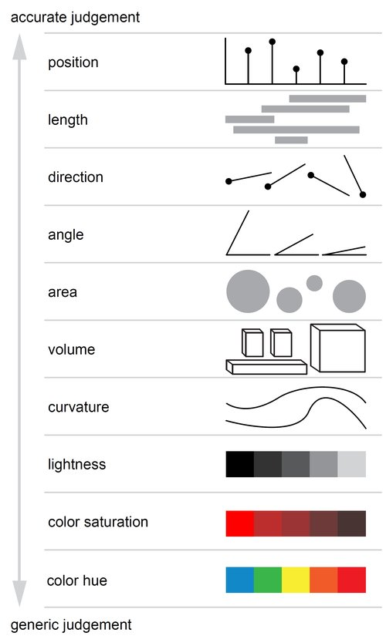
Element 2 – Abstract What type of abstraction is supposed to represent your data? Define and representation.
Some general guidelines from hallmark graphics study on accuracy perception by Cleveland & McGill 1984
Source: Adapted from Cleveland & McGill – From
https://www.gabrielaplucinska.com/blog/2017/8/7/pie-charts

Slide 25
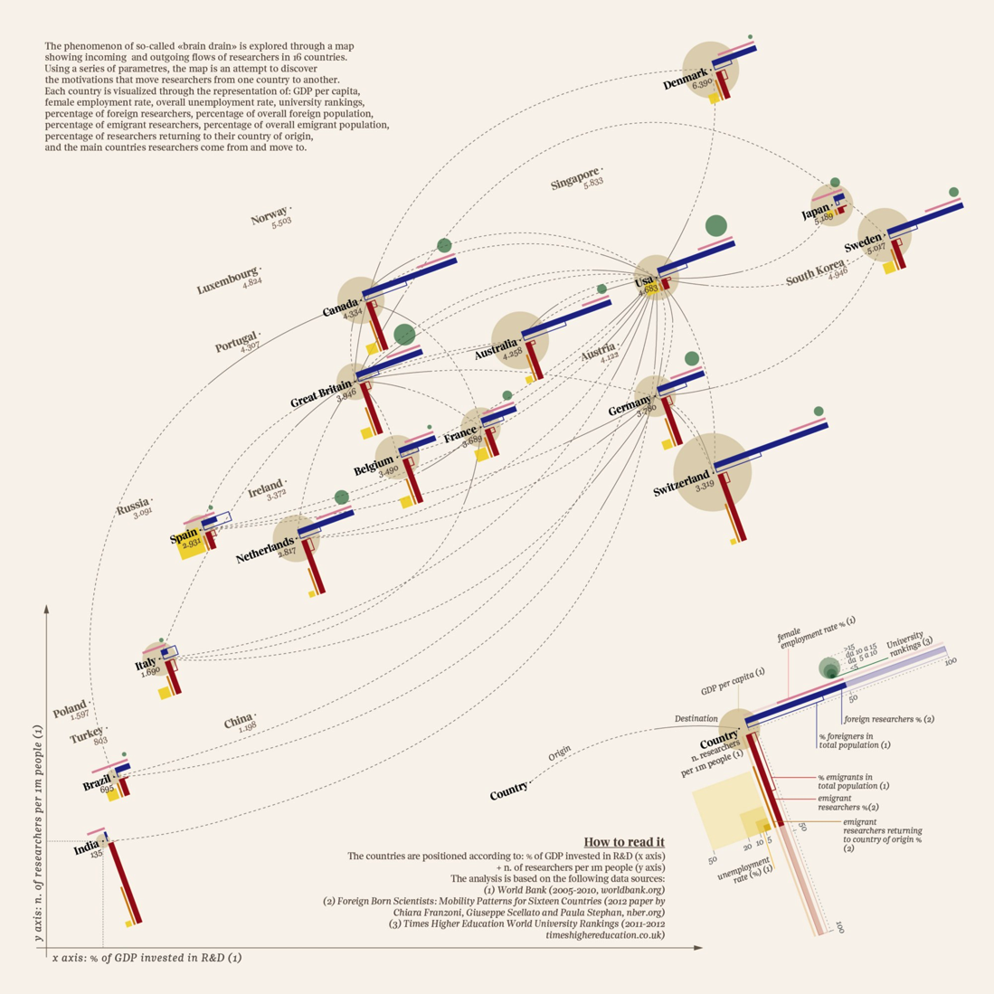
Element 2 – Abstract You can get rather creative here – for example – This chart is creating a new style of abstraction to communicate “brain drain” between 16 countries
Source: The global Brain Drain — Accurat for La Lettura, Corriere della Sera

Slide 26
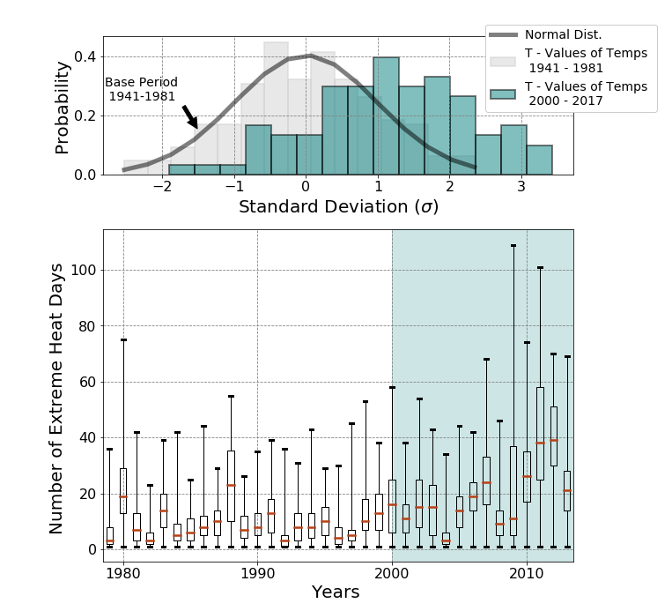
Element 3 – Color Use color to highlight, to show relationships, to indicate values “colors are the mother tongue of the subconscious” – Carl Jung
We spend a lot of our time with colors in making visualizations
Here we tied together two times periods by signifying color
Figure from https://github.com/astro-abby/
Based on Frankel and DePace, 2012.

Slide 27

Element 3 – Color Some guidelines of color in design
Consider Conveying Information Or Meaning By Color Choice –
Red usually will highlight something extreme or something “hot”, blue is more “sedate”
In general if you are graphing a location - green is good for land, blue for ocean etc
Based on Adams, 2008.
Old Guitarist – Pablo Picasso

Slide 28
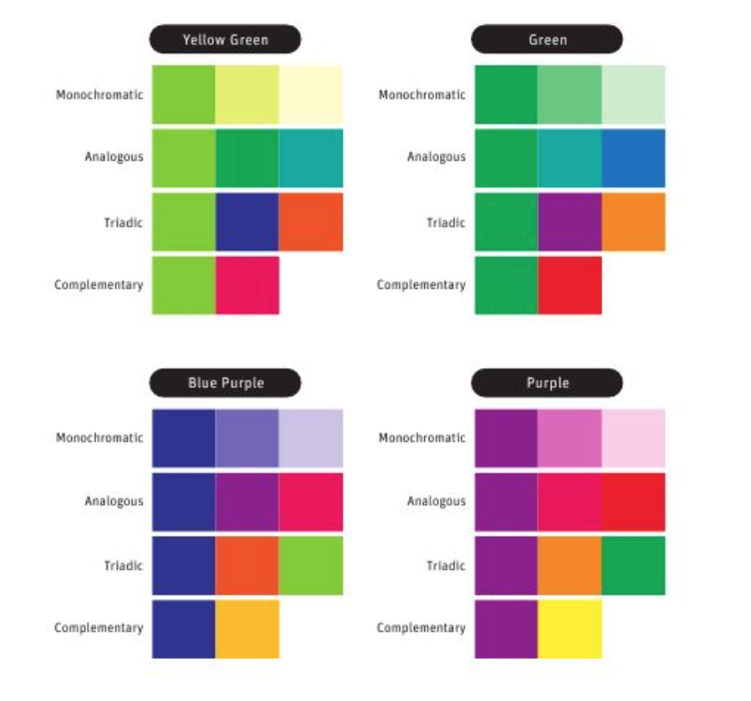
Element 3 – Color Some guidelines of color in design
Once you choose a color – create color harmony
Suggestions for building a color palette –
Choose a primary color – and then accent around it
Do not overload on colors, usually 5 or less is good enough
Play around – what looks good? What accentuates difference?
Based on Adams, 2008.

Slide 29
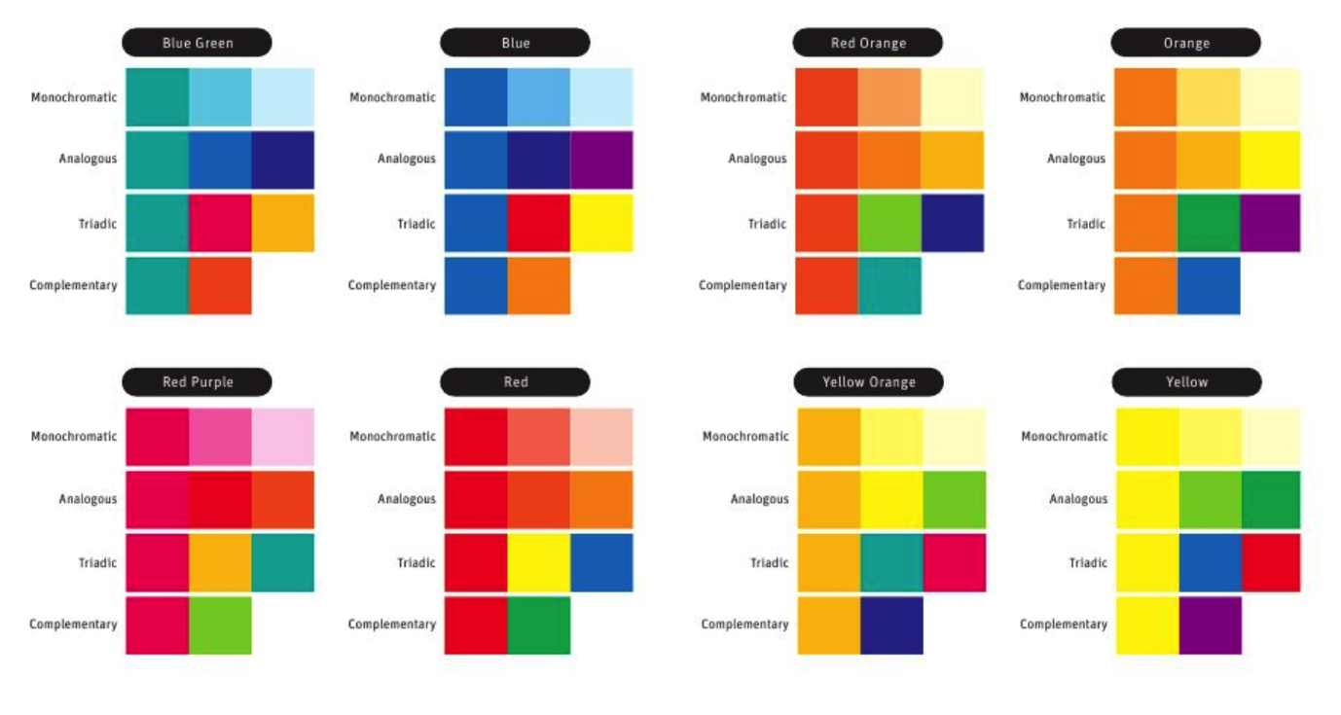
Element 3 – Color Some guidelines of color in design
Example of color choice in action – these are classic pallets to put together – you can find more of course online
Based on Adams, 2008.

Slide 30
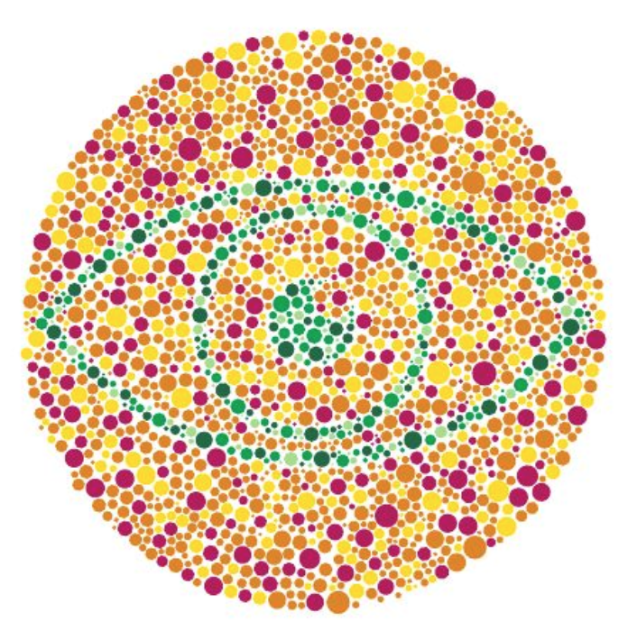
Element 3 – Color Some guidelines of color in design
People see colors differently
Good colors to avoid:
Red & Green in combo
Resource: You can get “hex codes” and palettes from a variety of websites – my favorites [1], [2], [3]
Based on Adams, 2008.

Slide 31
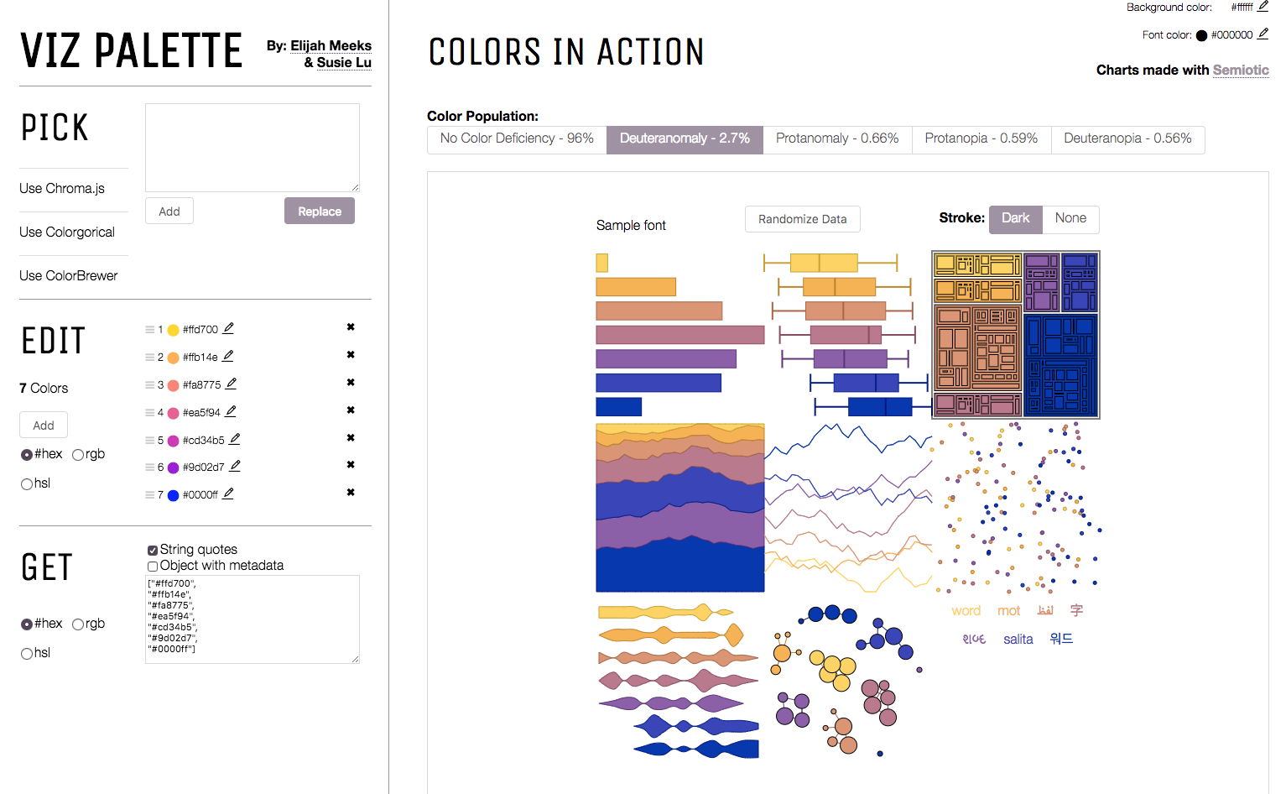
Element 3 – Color Some guidelines of color in design
People see colors differently
Good colors to avoid:
Red & Green in combo
Resource: You can get “hex codes” and palettes from a variety of websites – my favorites [1], [2], [3]
http://projects.susielu.com/viz-palette
Based on Adams, 2008.

Slide 32
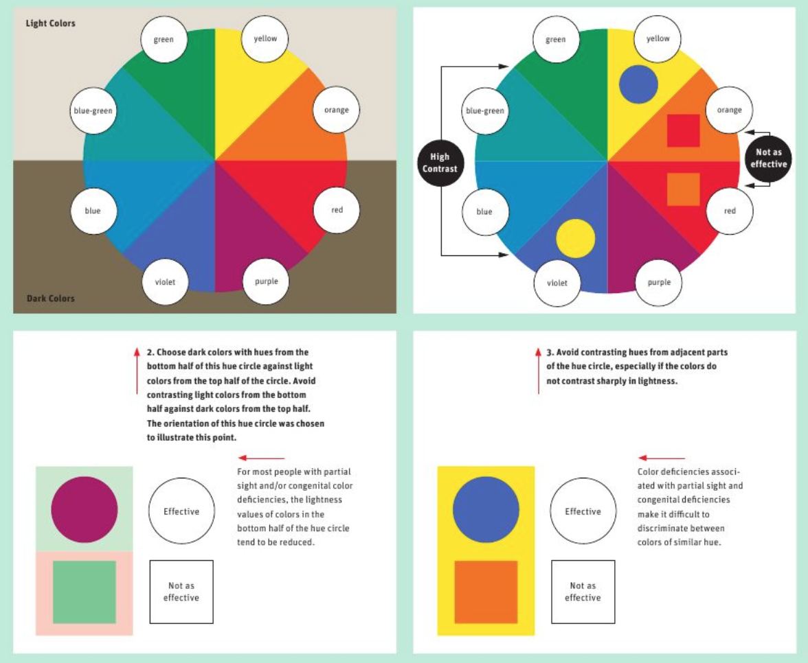
Element Color Some guidelines of color in design
People see colors differently
Try to vary in hue AND saturation
Feel free to experiment!
Based on Adams, 2008.

Slide 33
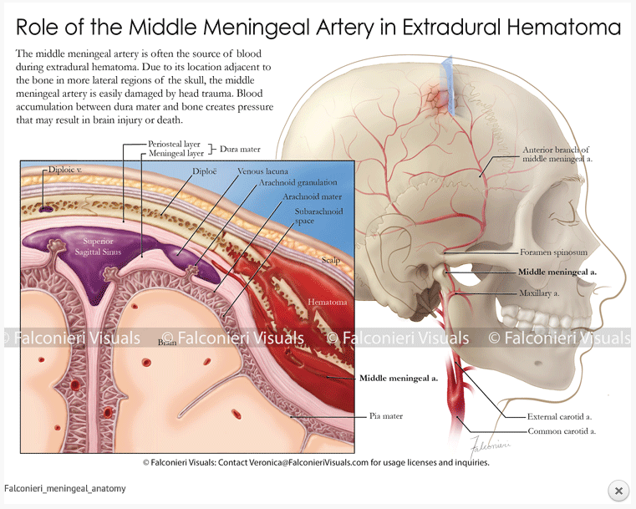
Element 4 – Layering Add layers to express meaning
From V. Falconieri – biological illustrator
http://falconierivisuals.com/
Based on Frankel and DePace, 2012.

Slide 34
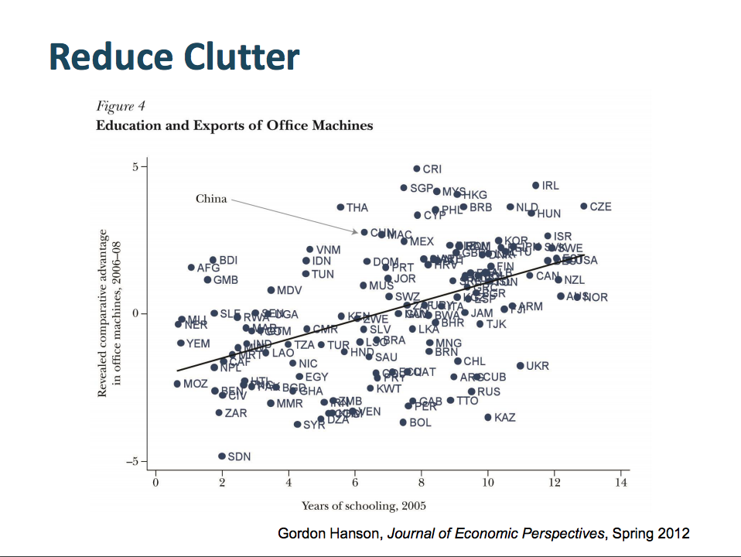
Element 5 – Refine Once you have a good figure – simplify to express meaning
Based on Frankel and DePace, 2012.
Adapted from Telling Visual Stories About Data, Congressional Budget Office, Fontaine, 2014.

Slide 35
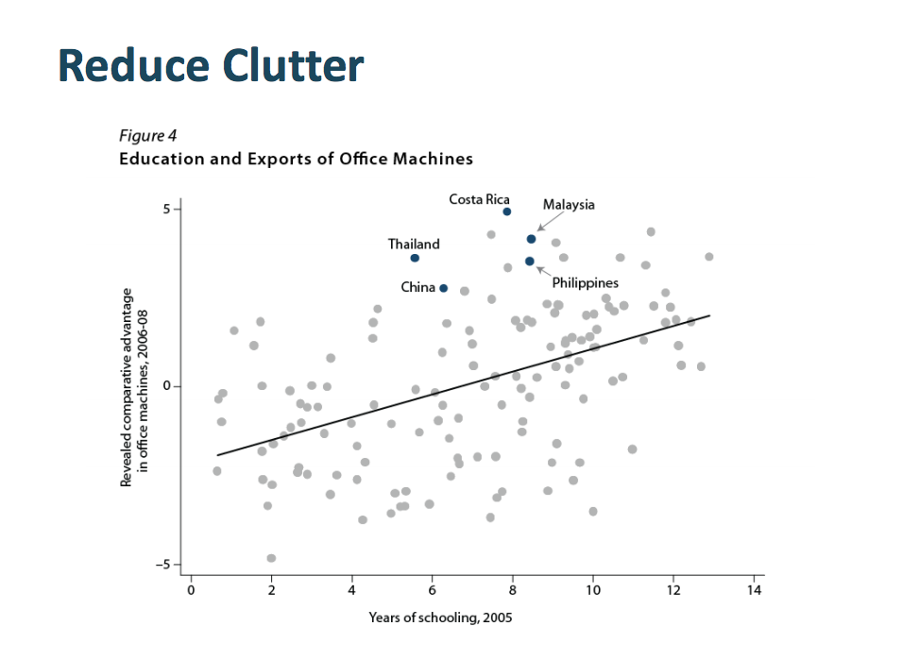
Element 5 – Refine Once you have a good figure – simplify to express meaning
Based on Frankel and DePace, 2012.
Adapted from Telling Visual Stories About Data, Congressional Budget Office, Fontaine, 2014.

Slide 36
What we’ve learned
When starting a visualization for data consider what is the main point of my graphic and what is my audience?
Is my graphic explanatory or exploratory?
How will it be used?
What is the first thing you want your audience to see?
When making a figure consider:
Composition
Abstraction
Coloring (make sure to consider colorblind palettes!)
Layering
Refining

Slide 37
Let’s put what we’ve learned into practice
Consider these as we watch the following video - http://players.brightcove.net/679256133001/NkgrDczuol_default/index.html?videoId=5373954480001
This won the NSF Expert’s Choice award in 2017 for best video visualization.
Think as we watch this how these use the elements to address their audience
Composition
Abstraction
Coloring
Layering
Refining

Slide 38
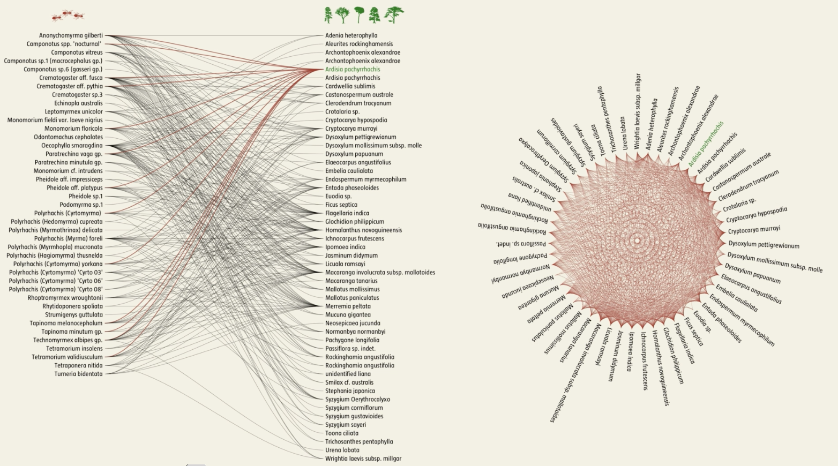
Source: Network Earth, Mauro Martino, Jianxi Gao, Baruch Barzel, Albert-László Barabási. Narration: Shamini Bundell

Slide 39
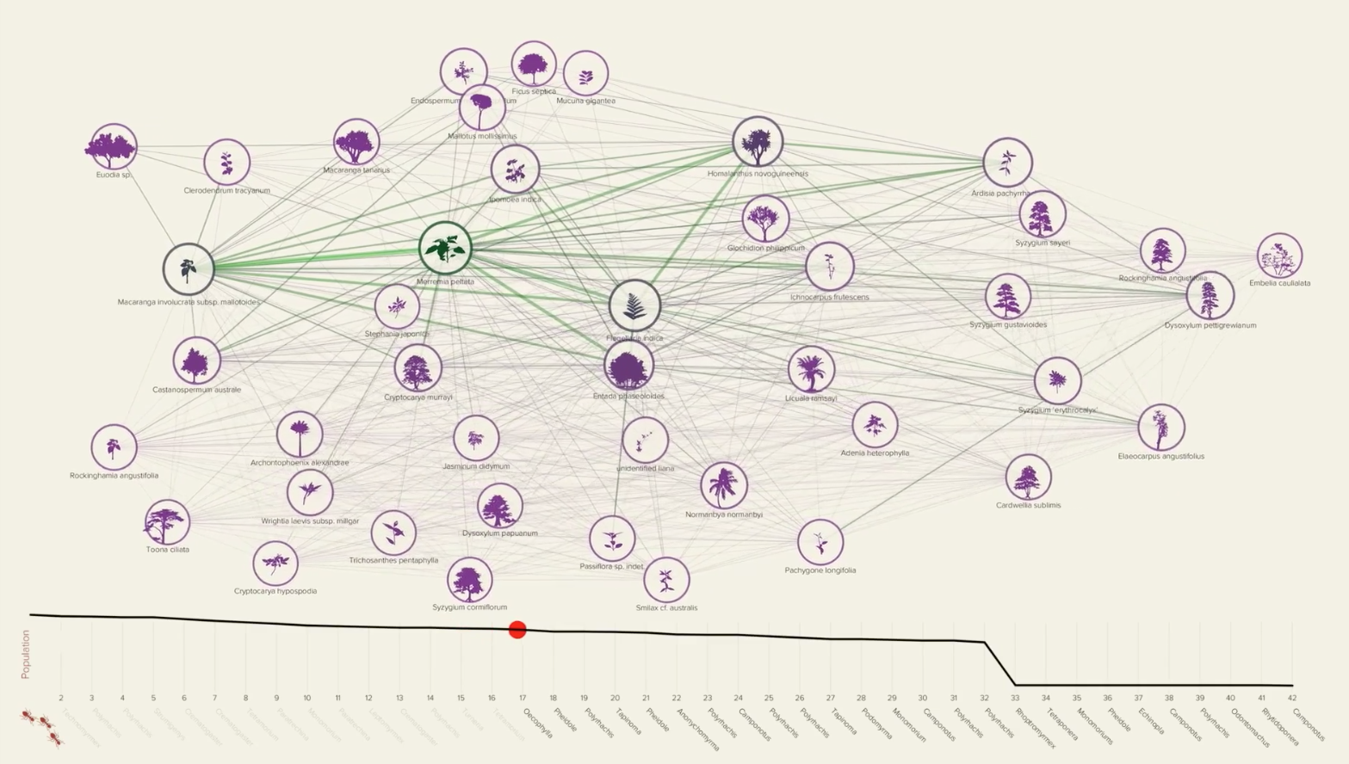
Source: Network Earth, Mauro Martino, Jianxi Gao, Baruch Barzel, Albert-László Barabási. Narration: Shamini Bundell

Slide 40
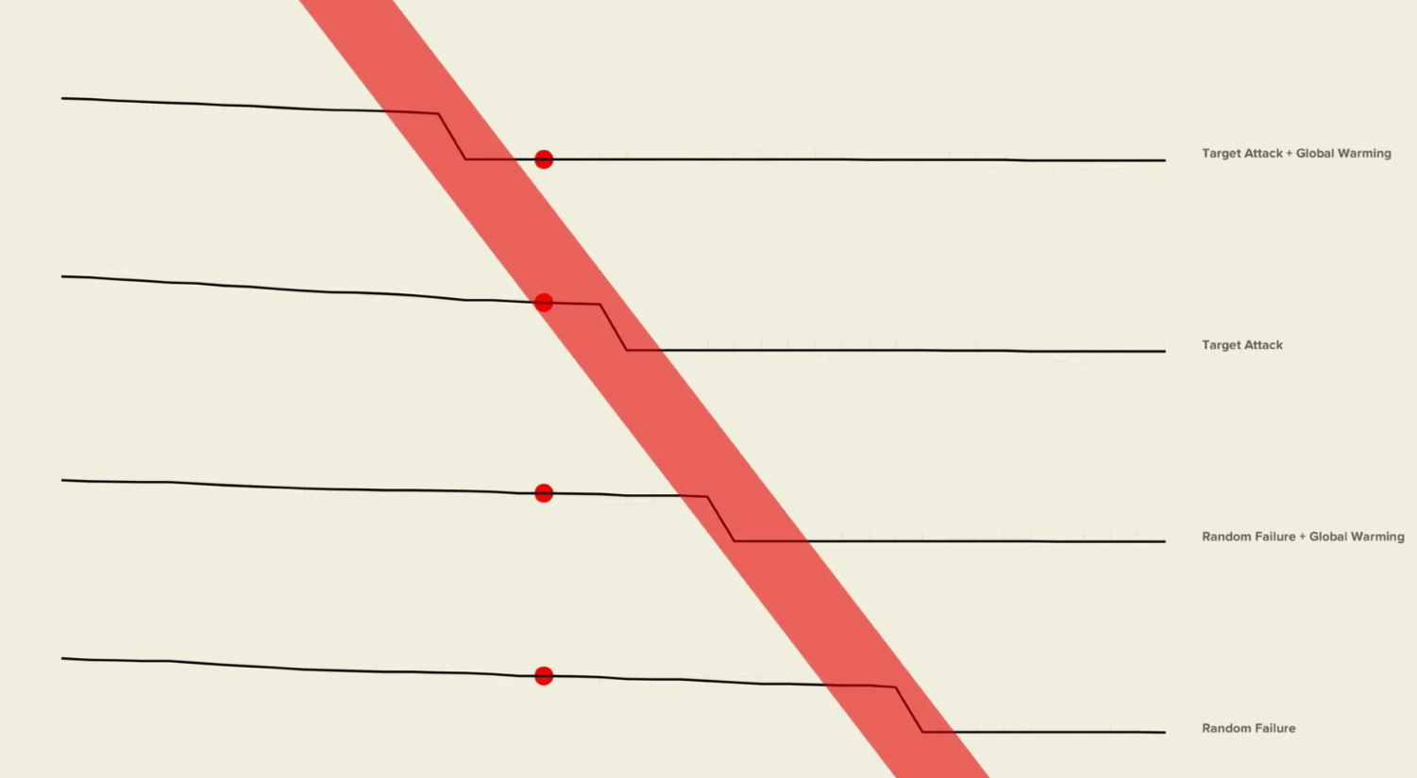
Source: Network Earth, Mauro Martino, Jianxi Gao, Baruch Barzel, Albert-László Barabási. Narration: Shamini Bundell

Slide 41
On Thursday! Python -
We will be using the basics plotting / visualization package called matplotlib (the documentation is amazing)
This is commonly used in Python as:
import matplotlib.pyplot as plt
This is not the ONLY plotting package – the other popular one for data science and stats is seaborn
In the following session we will see a brief teaser of what matplotlib can do – the Jupyter notebook includes hyperlinks to resources and other information as you get started (will be posted on ICOS)
Also feel free to check out the Github here
this is lab section of a new class in Climate and Space (4 credits for ugrad and grad) that teaches data visualization and statistics – novices are welcome!

